Slide 1


jBoss BPM Overview
Notes:
Welcome back to the forth module of data science.

Slide 2
Agenda
01
02
03
What is jBPM?
What does jBPM do?
Kie workbench
04
05
06
authoring
Data modeler
Form modeler
07
08
09
simulation
Process Definitions
Process instances

Slide 3
Agenda
10
11
12
Task List
Execution Errors
Metrics
13
14
15
eclipse
QUIZ
conclusion

Slide 4
What is jBPM?

Slide 5
What is jBPM?
jBPM is a flexible Business Process Management (BPM) Suite.
It makes the bridge between business analysts and developers.
Traditional BPM engines have a focus that is limited to non-technical people only.
jBPM has a dual focus: it offers process management features in a way that both business users and developers like it.

Slide 6
What does jBPM do?

Slide 7
What does jBPM do?
A business process allows you to model your business goals by describing the steps that need to be executed to achieve that goal and the order, using a flow chart.
This greatly improves the visibility and agility of your business logic, results in higher-level and domain-specific representations that can be understood by business users and is easier to monitor.
The core of jBPM is a light-weight, extensible workflow engine written in pure Java that allows you to execute business processes using the latest BPMN 2.0 specification. It can run in any Java environment, embedded in your application or as a service.
On top of the core engine, a lot of features and tools are offered to support business processes throughout their entire life cycle:
Eclipse-based and web-based editor to support the graphical creation of your business processes (drag & drop).
Pluggable persistence and transactions based on JPA / JTA.
Pluggable human task service based on WS-HumanTask for including tasks that need to be performed by human actors.
Management console supporting process instance management, task lists and task form management, and reporting.
Optional process repository to deploy your process (and other related knowledge).
History logging (for querying / monitoring / analysis).
Integration with Seam, Spring, OSGi, etc.

Slide 8
What does jBPM do?
BPM makes the bridge between business analysts, developers and end users, by offering process management features and tools in a way that both business users and developers like it. Domain-specific nodes can be plugged into the palette, making the processes more easily understood by business users.
jBPM supports adaptive and dynamic processes that require flexibility to model complex, real-life situations that cannot easily be described using a rigid process. We bring control back to the end users by allowing them to control which parts of the process should be executed, to dynamically deviate from the process, etc.
jBPM is also not just an isolated process engine. Complex business logic can be modeled as a combination of business processes with business rules and complex event processing. jBPM can be combined with the Drools project to support one unified environment that integrates these paradigms where you model your business logic as a combination of processes, rules and events.

Slide 9
KIE Workbench
Business Central

Slide 10
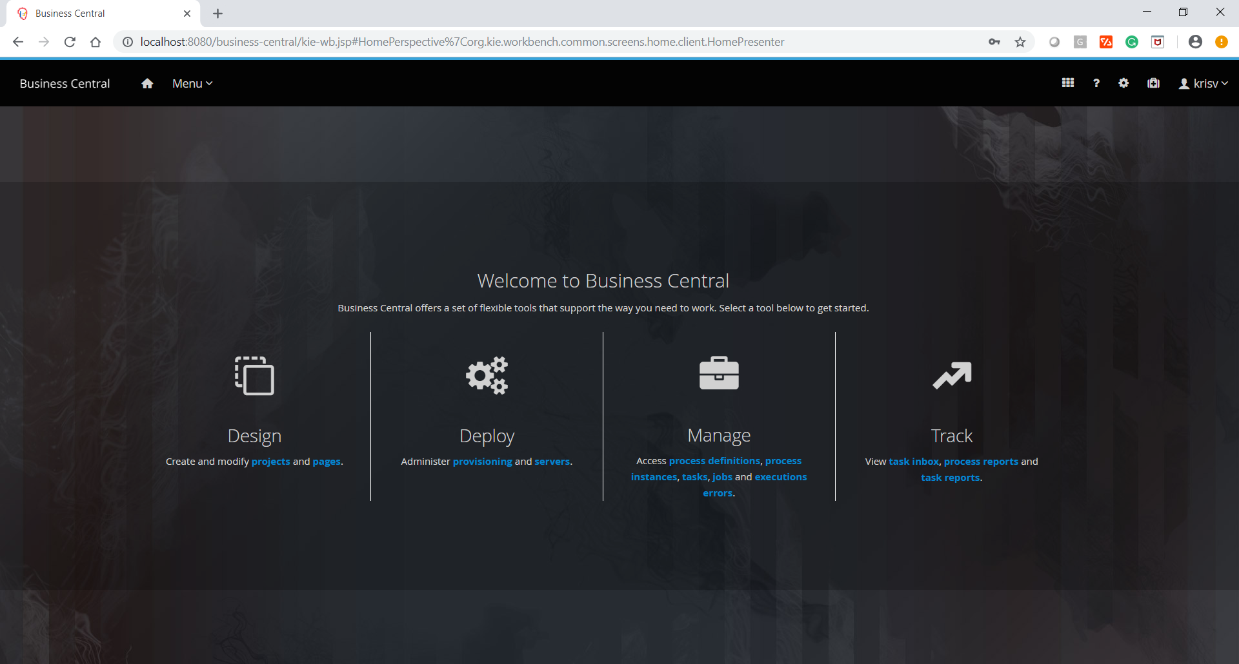
KIE Workbench

Slide 11
Authoring
Business Central

Slide 12
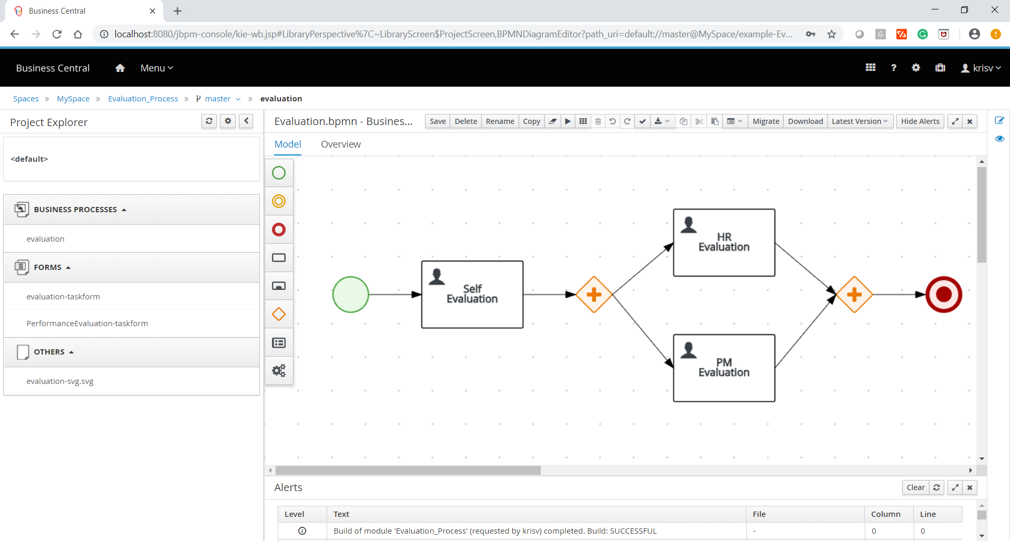
Authoring

Slide 13
Data Modeler
Business Central

Slide 14
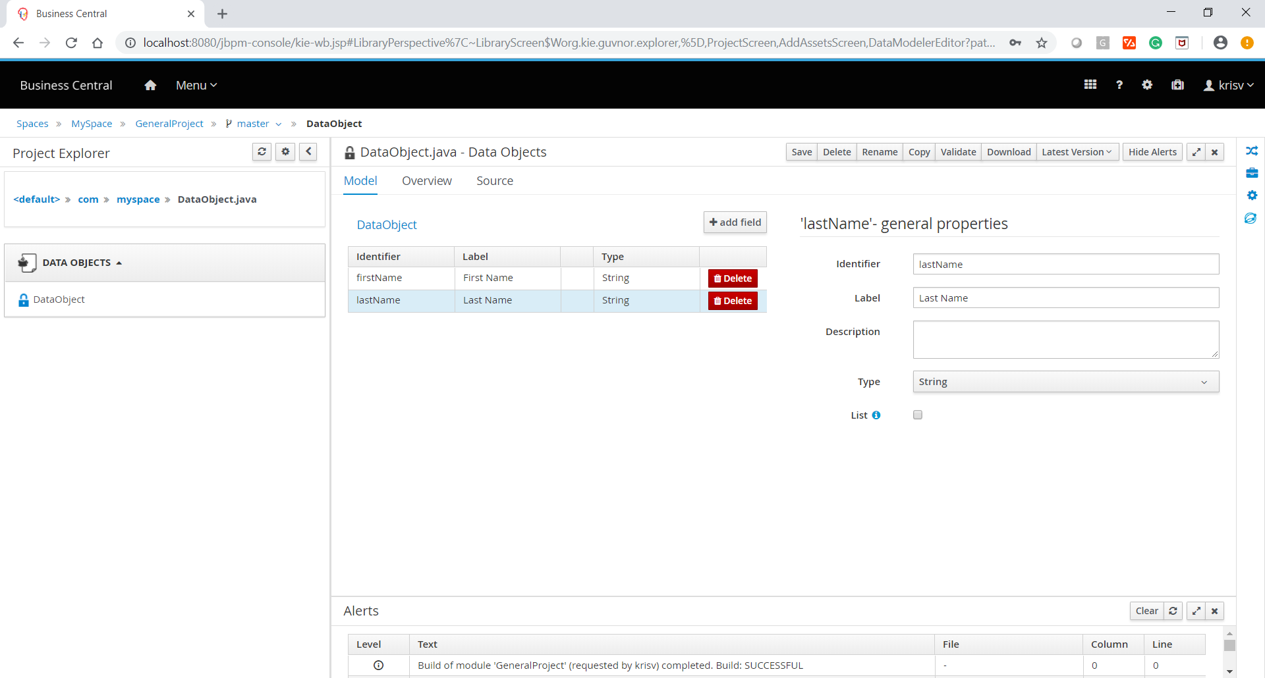
Data Modeler

Slide 15
Form Modeler
Business Central

Slide 16
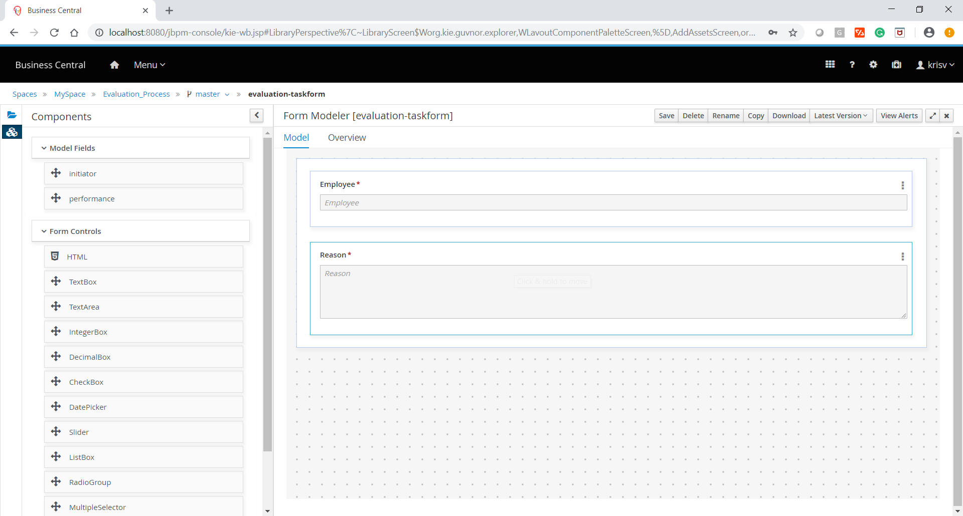
Form Modeler

Slide 17
Simulation
Business Central

Slide 18
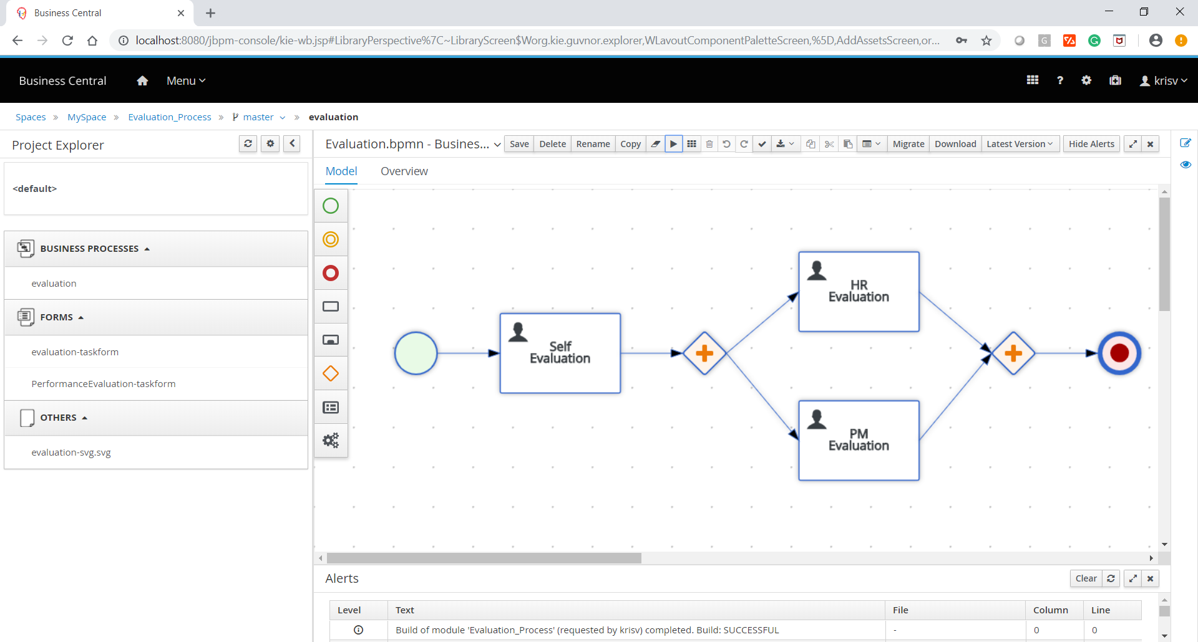
Simulation

Slide 19
Process Definitions
Business Central

Slide 20
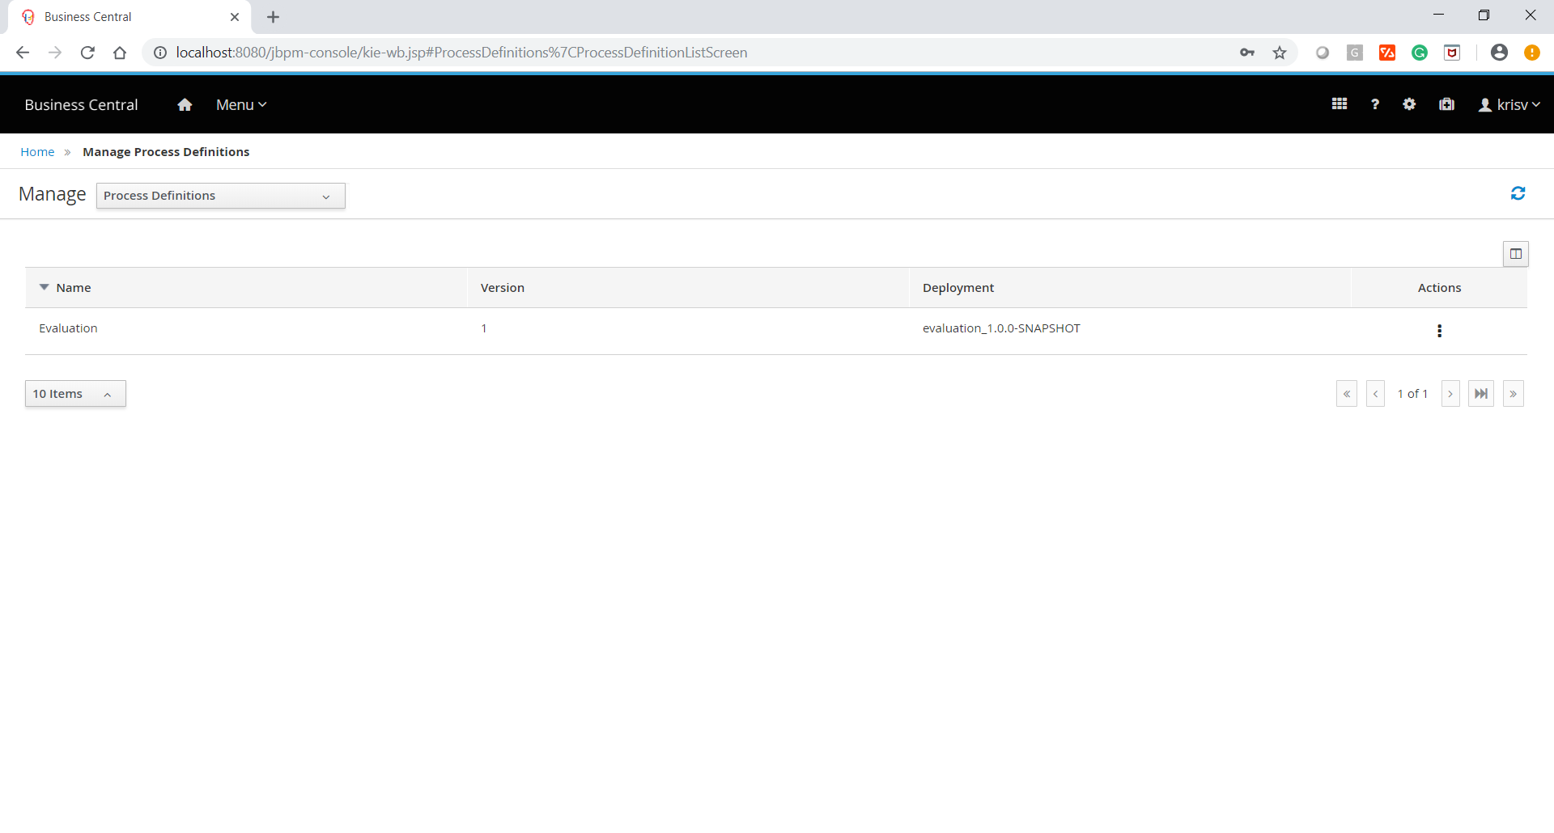
Process Definitions

Slide 21
Process Instances
Business Central

Slide 22
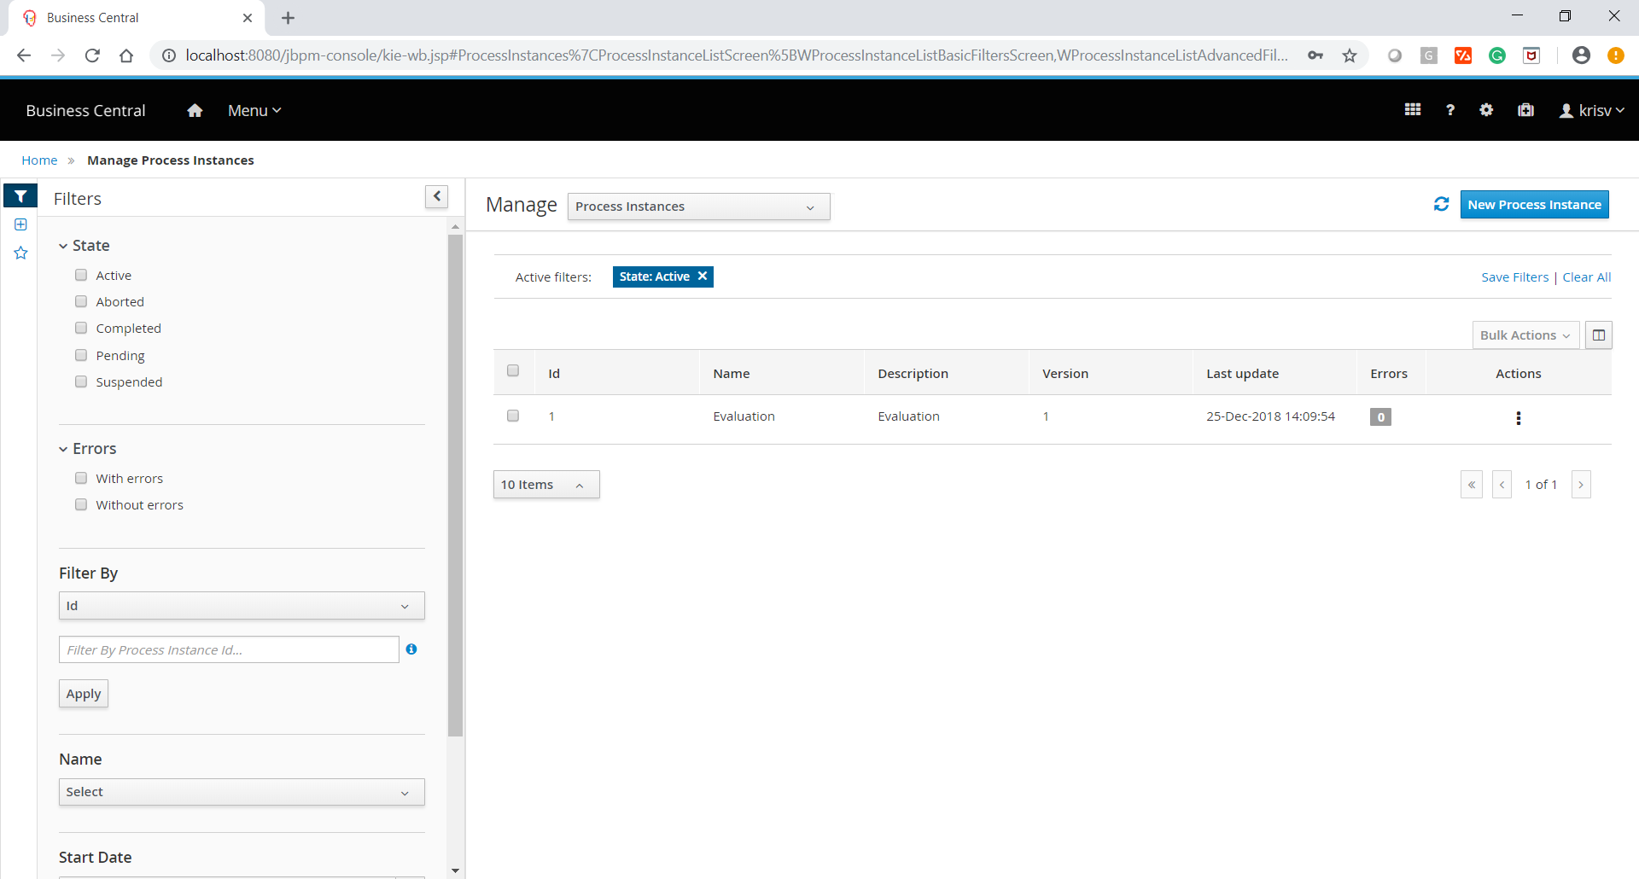
Process Instances

Slide 23
Task List
Business Central

Slide 24
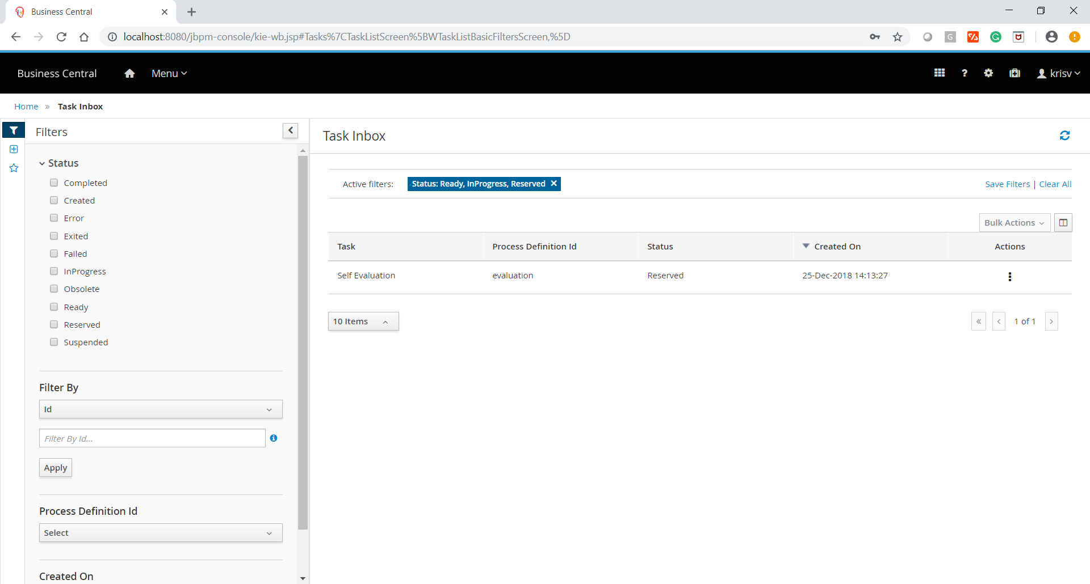
Task List

Slide 25
Jobs
Business Central

Slide 26
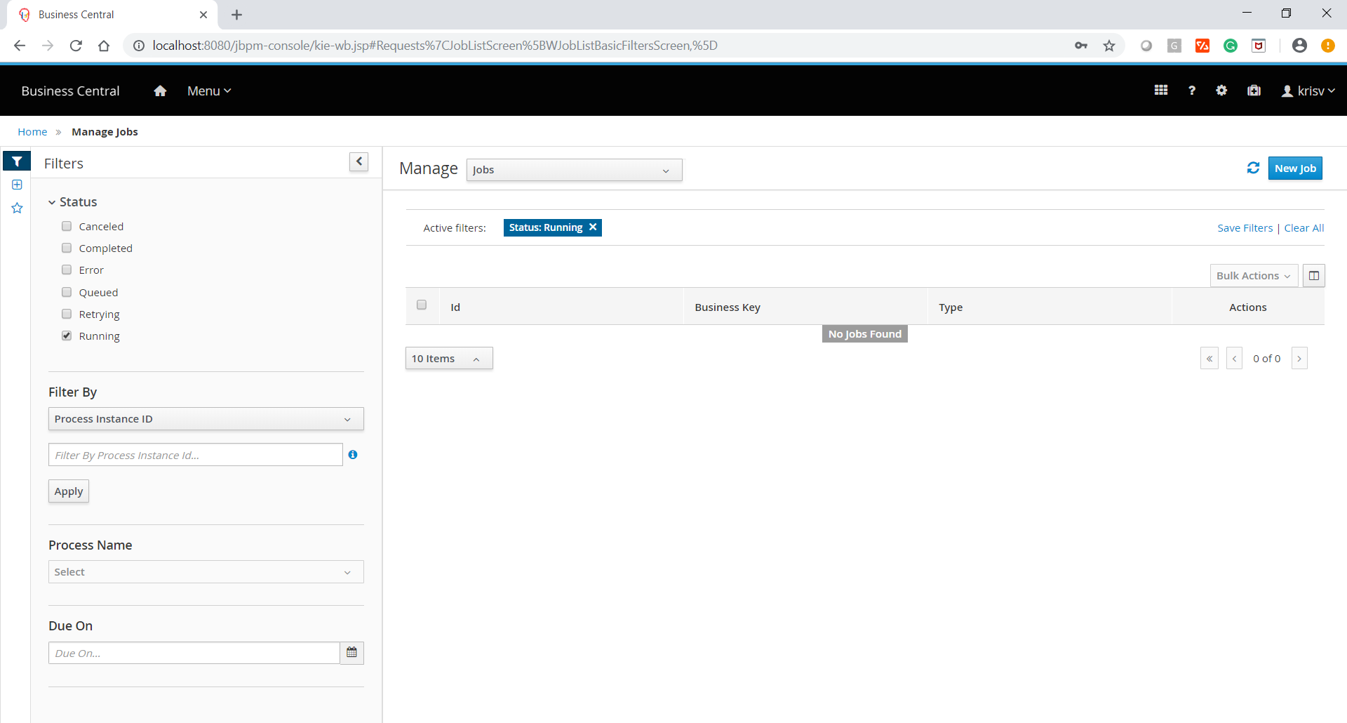
Jobs

Slide 27
Execution Errors
Business Central

Slide 28
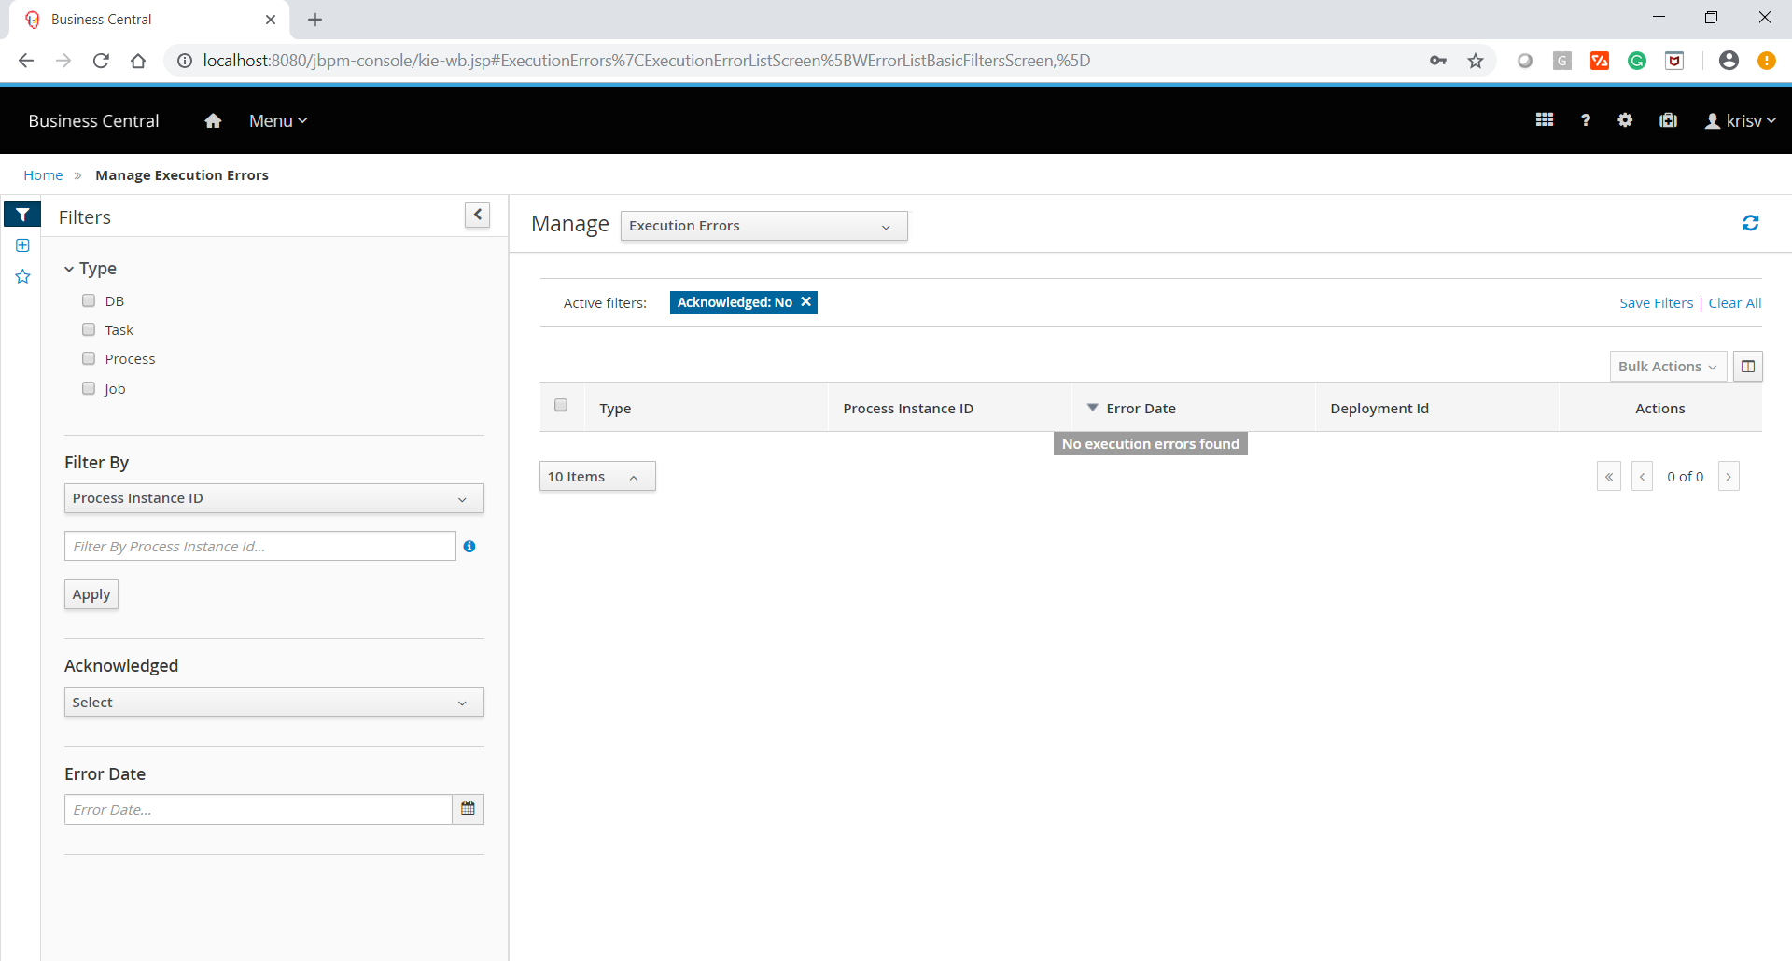
Execution Errors

Slide 29
Metrics
Business Central

Slide 30
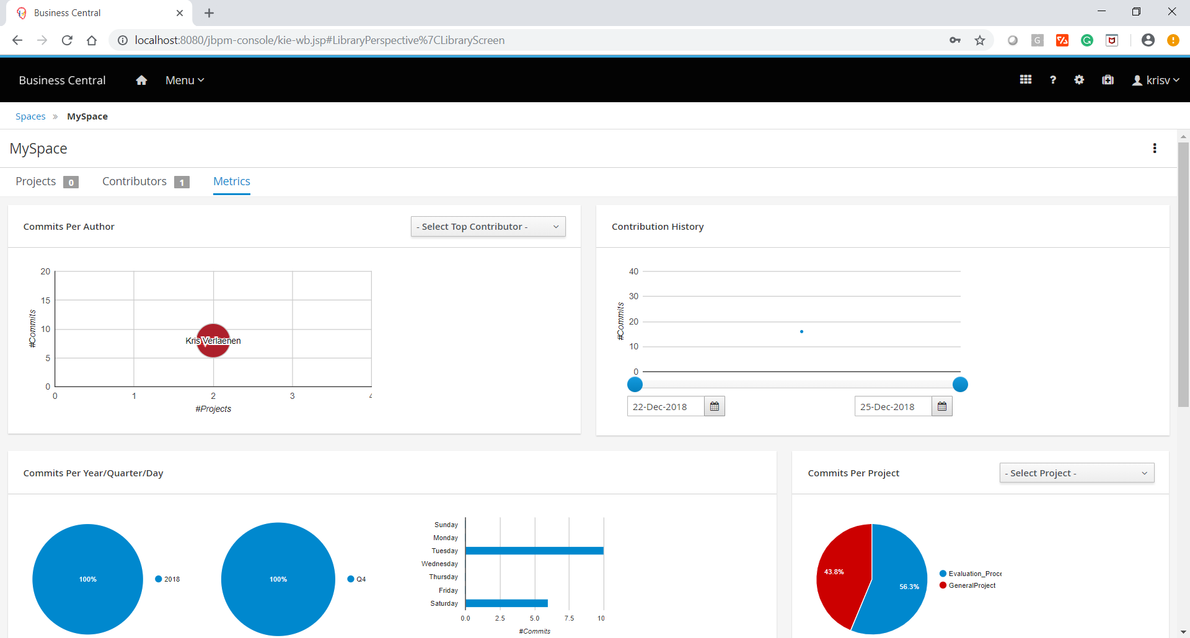
Metrics

Slide 31
Eclipse
Java, Maven

Slide 32
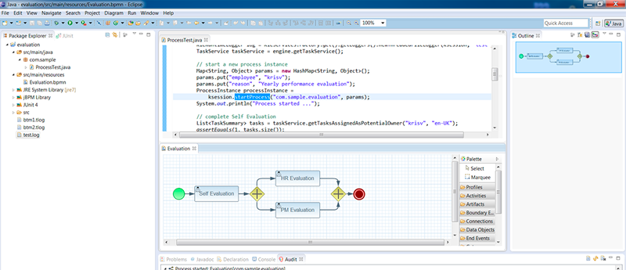
Eclipse

Slide 33

Quiz
Introduction to jBPM

Slide 34
Quiz
Eclipse requires for below artifact
Start Event
User Task
Service Task
Script Task

Slide 35

Answer
Eclipse requires for below artifact
Start Event
User Task
Service Task
Script Task

Slide 36
Quiz
Process Instances are in which section from KIE Workbench?
Track
Deploy
Design
Manage

Slide 37
Answer
Process Instances are in which section from KIE Workbench?
Track
Deploy
Design
Manage

Slide 38
Quiz
You can instantiate process from below URL
Process Instances
Tasks
Process Definitions
Jobs

Slide 39
Answers
You can instantiate process from below URL
Process Instances
Tasks
Process Definitions
Jobs

Slide 40
Conclusion

Slide 41


Summary
In this session, you must have learnt about:
What is jBPM?
What does jBPM do?
Kie workbench
Authoring
Data modeler
Form modeler
Simulation
Process Definitions
Process instances
Task List
Execution Errors
Metrics
Eclipse

Slide 42


India : +91-7847955955
US : 1-800-216-8930 (TOLL FREE)
support@intellipaat.com
24X7 Chat with our Course Advisor
Notes:
Thank you!

